Slide 1
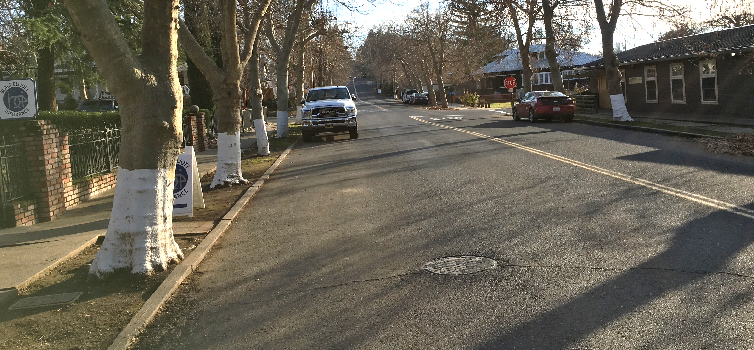
TCSD Collection System project CWSRF PROJECT NO. C-06-8281-210
August 4, 2021

Slide 2
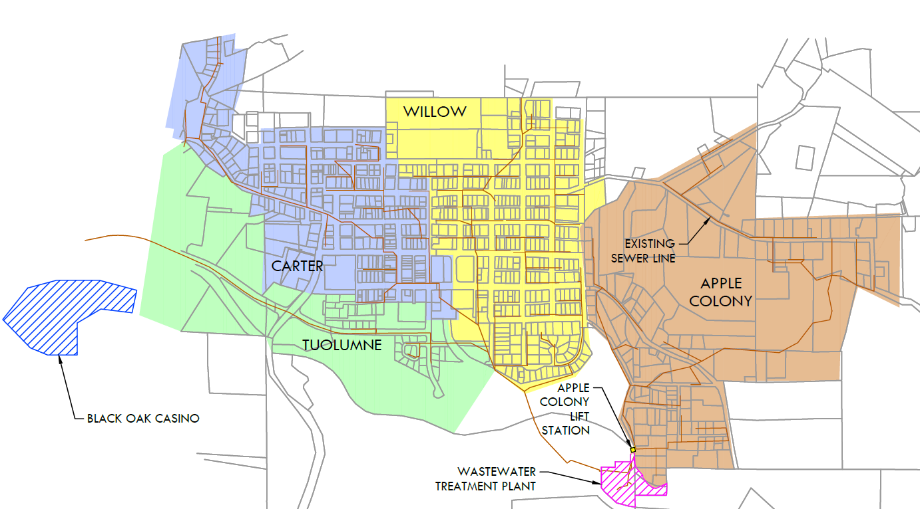
Project Overview
This project addresses the issue of aging infrastructure
Funded through the Clean Water State Revolving Fund
The Carter Basin was constructed in the 1950’s, primarily with VCP
The design phase includes the entire Carter Basin
Phase I of construction will include the SOUTHERN portion of the Carter Basin

Slide 3
Project timeline
2016
Application for Planning Funds
2018
Planning Phase
2020
Application for Construction Funds
2021
Project Design
Summer 2022
Construction phase begins
December 2023
End of Construction

Slide 4
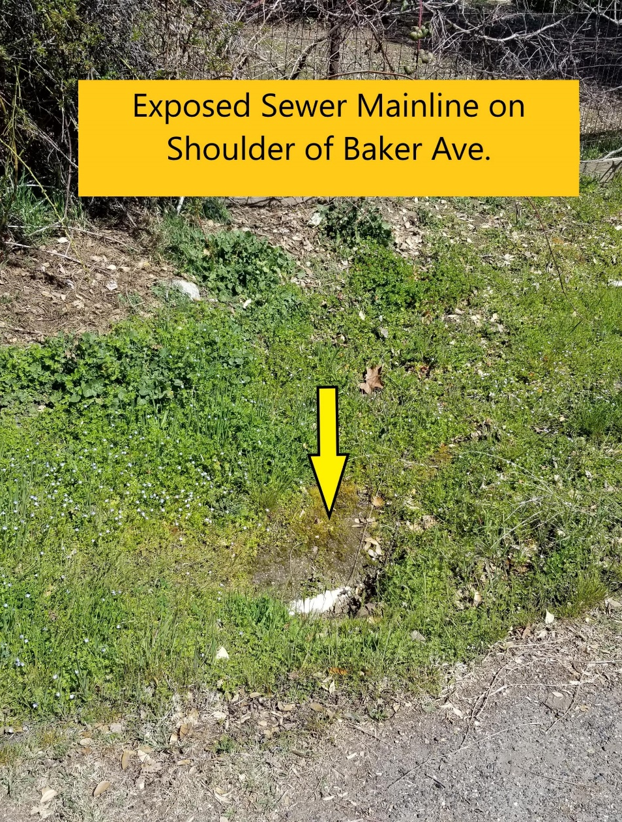
Collection system improvements
SEWER MAINS
Replacement of deteriorating and undersized sewer mains
New pipe will be 6 and 8-inch PVC
MANHOLES AND CLEANOUTS
Replacement, rehabilitation, and abandonment of corroded manholes and cleanouts
LATERAL CONNECTIONS
Reconnection and replacement of laterals
Relocation of some sewer mains out of easements and into ROW
Addition of new manholes and cleanouts
ROADWAYS
Repaving of impacted roadways
Rerouting laterals from private property to the public right-of-way

Slide 5
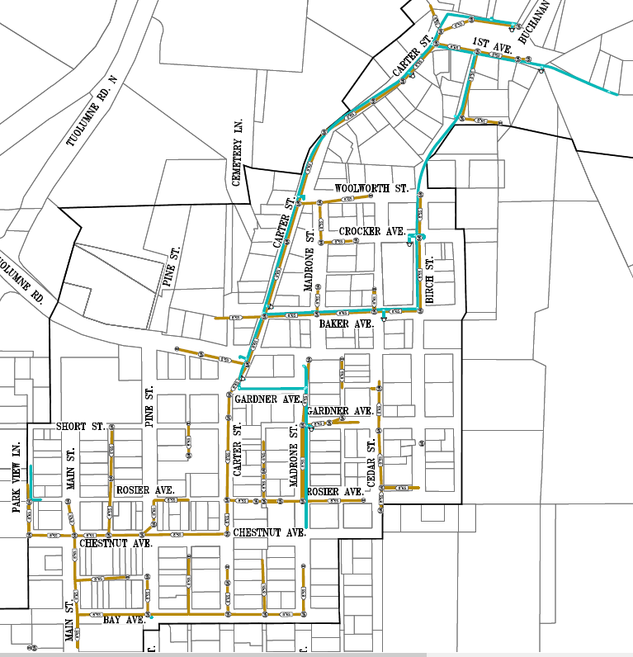
PROPOSED TCSD/TUD COLLABORATION

Slide 6
PROPOSED CONSTRUCTION PHASE 1

Slide 7
Funding AGREEMENT
Construction: $4,184,160
Contingency: $575,689
Allowances: $997,047
Total: $5,756,896

Slide 8
Way Forward
Final Design
(Jan 2022)
BID PROJECT
(Mar 2022)
Construction
(April 2022)
Project Closeout
(Jan 2024)

